Slide 1

Mastering HTML Fundamentals
This presentation will guide you through the essential HTML elements: Forms, Tables, and Lists. We'll explore their structure, common uses, and best practices for effective web content creation.

Slide 2




Capturing User Input with Forms
Interactive Elements
Key Components
Data Submission
Forms enable user interaction. They collect data for diverse purposes.
Input fields, labels, and buttons are core parts. Use semantic tags like FORM, INPUT, LABEL.
Data is sent to a server. Methods include GET and POST requests.

Slide 3
Structuring Form Elements
Text Inputs
Password Inputs
Radio Buttons
Checkboxes
<input type="text" id="name" name="name">
<input type="password" id="pass" name="pass">
<input type="radio" id="opt1" name="choice">
<input type="checkbox" id="agree" name="terms">
Used for single-line text data. Common for names or addresses.
Allow single selection from options. Grouped by the 'name' attribute.
Masks characters for security. Essential for user authentication.
Permit multiple selections. Good for preferences or agreements.

Slide 4

Beyond Basic Form Inputs
Textarea
Select Dropdown
Date Picker
For multi-line text input. Ideal for comments or messages.
Creates a dropdown list. Users choose from predefined options.
A specialized input for dates. Simplifies date entry and validation.
<textarea id="msg" name="msg"></textarea>
<select id="city" name="city"><option value="ny">NY</option></select>
<input type="date" id="eventDate" name="eventDate">

Slide 5
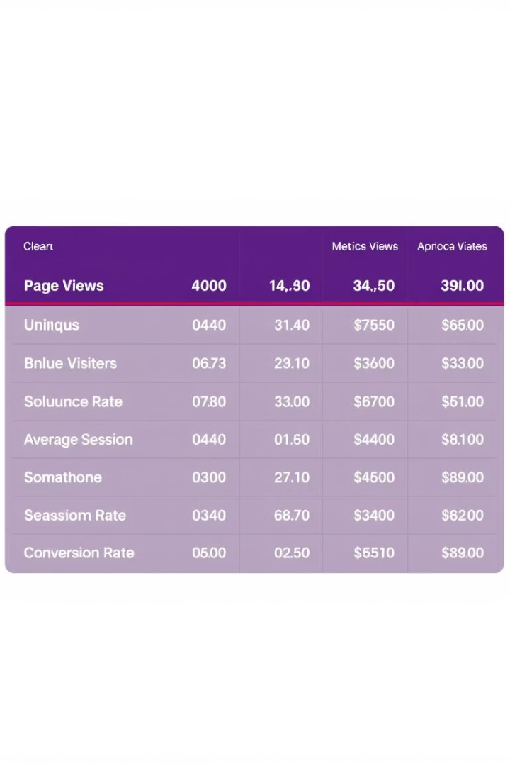



Organizing Data with Tables
Tabular Data
Tables display data in rows and columns. Ideal for comparisons.
Semantic Structure
TABLE, TR, TH, TD tags define structure. TH for headers, TD for data.
Accessibility
Use proper semantic tags. Improves readability for screen readers.

Slide 6
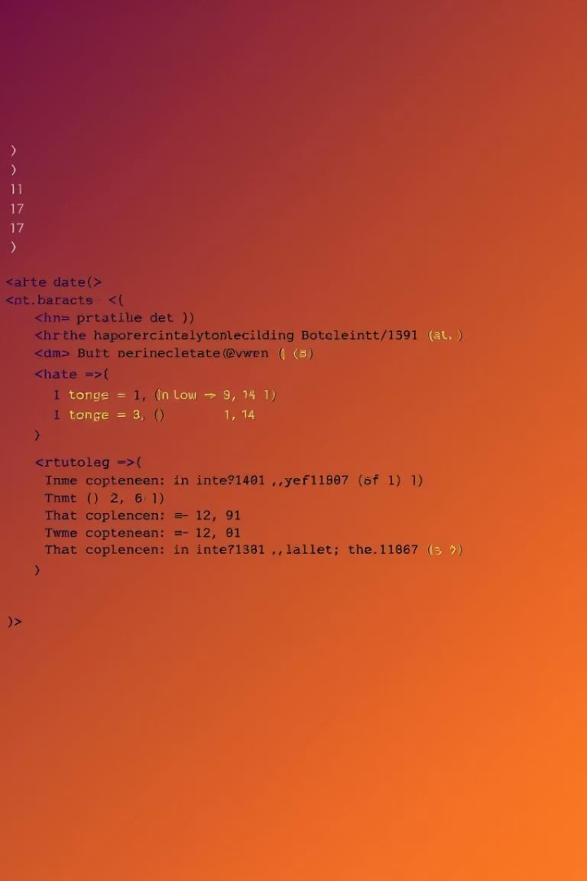
Building a Simple HTML Table
TABLE
The container for the table
<table></table>
TR
Defines a table row
<tr></tr>
TH
Table header cell
<th>Name</th>
TD
Table data cell
<td>John</td>
Tables are best for displaying tabular data, not for page layouts. Ensure correct nesting of elements for proper rendering.

Slide 7






Structuring Content with Lists
Hierarchical Content
Lists organize information. They create clear, readable structures.
Unordered Lists
UL tags create bulleted lists. Use for non-sequential items.
Ordered Lists
OL tags create numbered lists. Use for sequential steps or rankings.

Slide 8
Implementing HTML Lists
Unordered List Example
Ordered List Example
<ul> <li>Apples</li> <li>Bananas</li> <li>Oranges</li></ul>
<ol> <li>First step</li> <li>Second step</li> <li>Third step</li></ol>
These are useful for grocery lists. Also for features or ideas.
Ideal for step-by-step instructions. Also for recipes or processes.

Slide 9








Key Takeaways for Web Development
Semantic HTML
User Experience
Use appropriate tags. Improves accessibility and SEO.
Design with users in mind. Ensure forms and lists are intuitive.
Continuous Learning
Responsiveness
Web standards evolve. Stay updated with new practices.
Ensure elements adapt. Work well on all device sizes.

Slide 10



Next Steps for Aspiring Developers
Practice Building
Create small projects. Reinforce your HTML knowledge.
Explore CSS
Learn styling for visual appeal. Enhance your web pages.
Share Your Work
Get feedback. Contribute to open-source projects.

